Slide 1
Database Processing
Eighth Edition
Chapter 5
David M. Kroenke
The Relational Model and Normalization
© 2002 by Prentice Hall

Slide 2
The Relational Model
Broad, flexible model
Basis for almost all DBMS products
E.F. Codd defined well-structured “normal forms” of relations, “normalization”
© 2002 by Prentice Hall

Slide 3
Components of the Relational Model
Relation
  A two-dimensional table consisting of rows and columns
Tuples
  The rows (or records) in a relation
Attributes
  The columns (or fields) in a relation
© 2002 by Prentice Hall

Slide 4
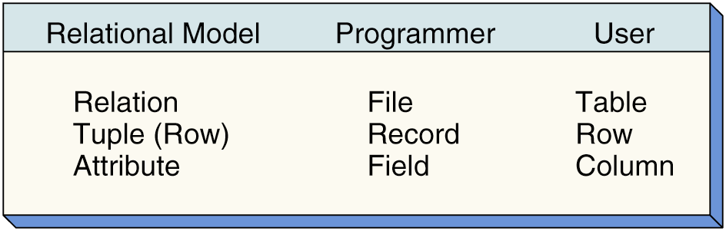
Terminology
© 2002 by Prentice Hall

Slide 5
Functional Dependency
Functional dependencies are the relationships among the attributes within a relation.
If attribute A functional depends on attribute B, then for every instance of B you will know the respective value of A.
© 2002 by Prentice Hall

Slide 6
Functional Dependency Notation
Major is functionally dependent on SID
    SID → Major
Grade is functionally dependent on the combination of SID and ClassID
    (SID, ClassID) → Grade
© 2002 by Prentice Hall

Slide 7
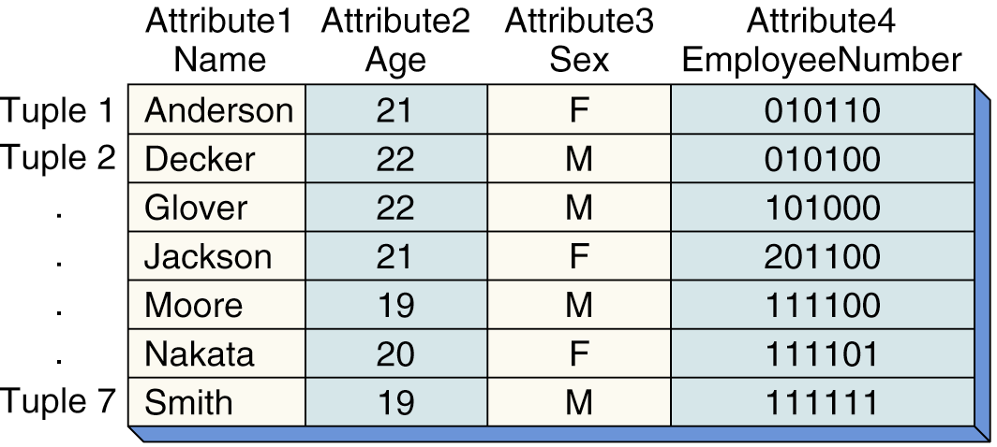
Functional Dependency
– an Example
EmployeeNumber → Name
EmployeeNumber → Age
EmployeeNumber → Sex
© 2002 by Prentice Hall

Slide 8
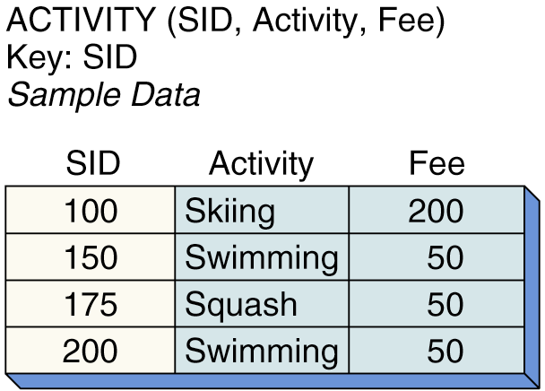
A Key
A key is a group of one or more attributes that uniquely identifies a tuple
© 2002 by Prentice Hall

Slide 9
A Combination Key
Sometimes more than one attribute will be required to uniquely identify a tuple.
If a key consists of more than one attribute, it is called a combination (or composite) key.
© 2002 by Prentice Hall

Slide 10
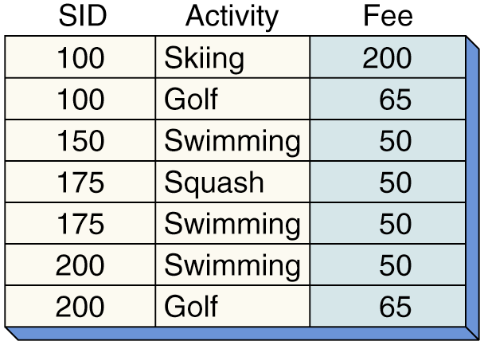
Example of a Combination Key
© 2002 by Prentice Hall

Slide 11
Normalization
Normalization is a process of evaluating and converting a relation to reduce modification anomalies
Essentially, normalization detects and eliminates data redundancy
© 2002 by Prentice Hall

Slide 12
An Anomaly
An anomaly is an undesirable consequence of a data modification.
© 2002 by Prentice Hall

Slide 13
Normal Forms
Normal forms are state-classes of relations which identify the level of anomaly-avoidance
© 2002 by Prentice Hall

Slide 14
Normal Forms Levels
1NF –First Normal Form
2NF –Second Normal Form
3NF –Third Normal Form
BCNF –Boyce-Codd Normal Form
4NF –Fourth Normal Form
5NF –Fifth Normal Form
DK/NF –Domain/Key Normal Form
© 2002 by Prentice Hall

Slide 15
First Normal Form (1NF)
To be in First Normal Form (1NF) a relation must have only single-valued attributes -- neither repeating groups nor arrays are permitted
© 2002 by Prentice Hall

Slide 16
Violation of 1NF
PlayerID | Name | Team | AtBats | Hits
123-45-6789 | Alomar, R | Cleveland, New York | 200, 120 | 50, 58
234-56-7890 | Alomar, S | Cleveland, Chicago | 60, 150 | 17, 40
Key: PlayerID
Determinants: PlayerID -> Name, Team, AtBats, Hits
© 2002 by Prentice Hall

Slide 17
Second Normal Form (2NF)
To be in Second Normal Form (2NF) the relation must be in 1NF and each nonkey attribute must be dependent on the whole key (not a subset of the key)
© 2002 by Prentice Hall

Slide 18
Violation of 2NF
ItemNo | CustomerID | Quantity | CreditRtg
12 | 57 | 25 | OK
34 | 679 | 3 | Poor
Key: ItemNo, CustomerID
Determinants: ItemNo, CustomerID -> Quantity
CustomerID -> CreditRtg
© 2002 by Prentice Hall

Slide 19
Third Normal Form (3NF)
To be in Third Normal Form (3NF) the relation must be in 2NF and no transitive dependencies may exist within the relation.
A transitive dependency is when an attribute is indirectly functionally dependent on the key (that is, the dependency is through another nonkey attribute)
© 2002 by Prentice Hall

Slide 20
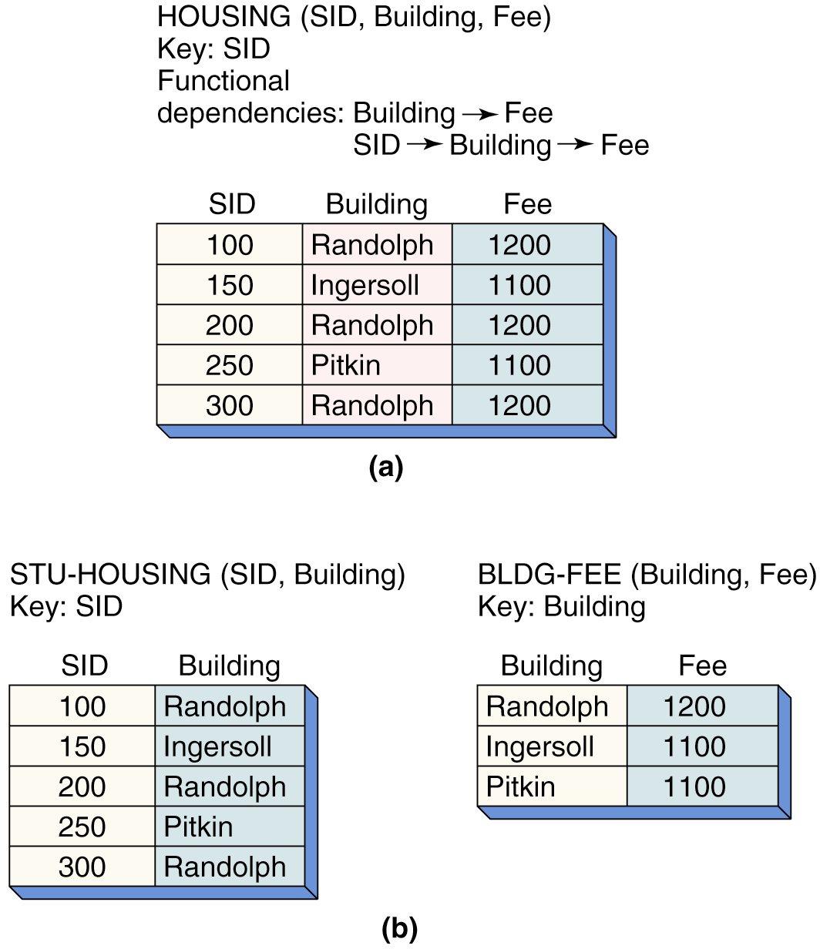
Violation of 3NF
© 2002 by Prentice Hall

Slide 21
Boyce-Codd Normal Form (BCNF)
To be in Boyce-Codd Normal Form (BCNF) the relation must be in 3NF and every determinant must be a candidate key.
© 2002 by Prentice Hall

Slide 22
Violation of BCNF
Client | ProbType | Consultant
Alpha | Marketing | Gomez
Alpha | Production | Raginski
Beta | Marketing | Gomez
Omega | Marketing | Taylor
Key: Client, ProbType
Candidate Key: Client, Consultant
Determinants: Consultant-> ProbType
* No two consultants have same name
* Consultant specializes in just one problem type
* Consultant can be assigned to multiple clients
© 2002 by Prentice Hall

Slide 23
Fourth Normal Form (4NF)
To be in Fourth Normal Form (4NF) the relation must be in BCNF and the relation may not contain multi-valued dependencies.
© 2002 by Prentice Hall

Slide 24
Fifth Normal Form (5NF)
The Fifth Normal Form concerns dependencies that are obscure and beyond the scope of this text.
© 2002 by Prentice Hall

Slide 25
Domain/Key Normal Form (DK/NF)
To be in Domain/Key Normal Form (DK/NF) every constraint on the relation must be a logical consequence of the definition of keys and domains.
© 2002 by Prentice Hall

Slide 26
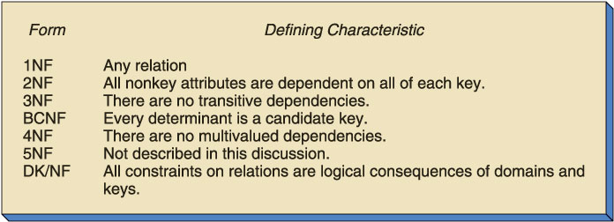
Summary of Normal Forms
© 2002 by Prentice Hall

Slide 27
Optimization
De-Normalization (a.k.a., Controlled Redundancy)
© 2002 by Prentice Hall

Slide 28
Database Processing
Eighth Edition
Chapter 5
David M. Kroenke
The Relational Model and Normalization
© 2002 by Prentice Hall

